Slide 1

Test Data Creation Framework

Slide 2
Typical Models
Improving Functionality
Copy and paste code from 1 unit test to another
Central class to create test data
Passing in a list of a key value pairs to functions

Slide 3
Drawbacks
If customer org has mandatory fields or validation rules your package unit tests probably won't pass
Typical models are not very flexible or easy to manage

Slide 4

The Framework

Slide 5
Benefits
Framework easily customisable so unit tests guaranteed to pass
Very flexible so any data structures can be created
Easy to learn, maintain and manage

Slide 6
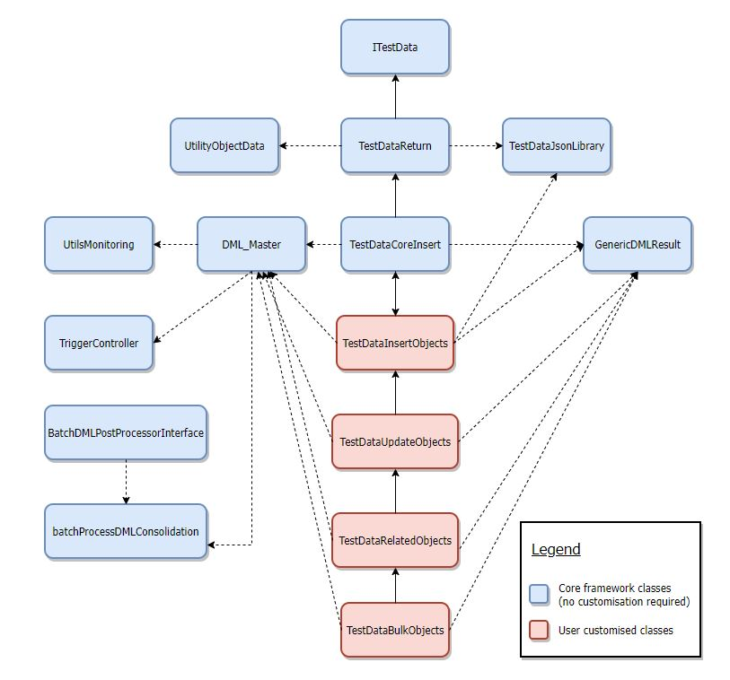
Class Structure

Slide 7
Code Example
Create an Account, Contact, Opportunity, Product and a Campaign data set all related records
TestDataRelatedObjects td = new TestDataRelatedObjects();
Account acc = td.insertAccountContctOppProdAndCampgn(null,null,null);
https://github.com/SteveFouracre/testdataframework

